Slide 1

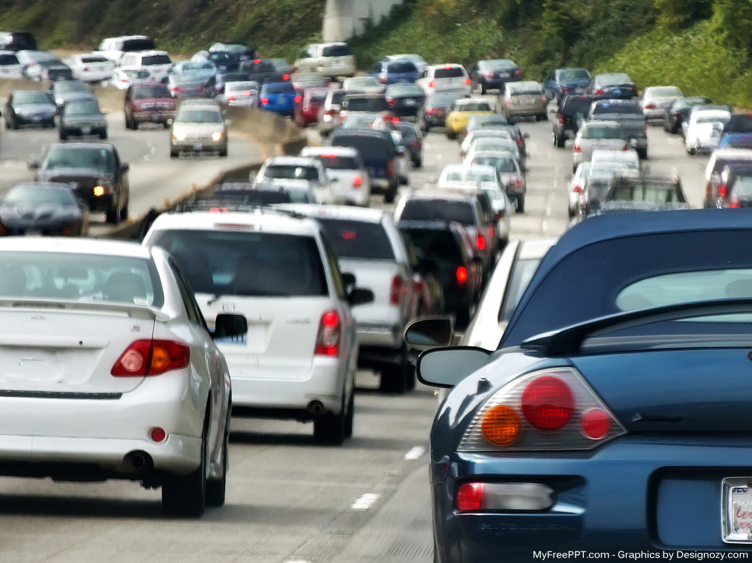
Vehicle Accident Prevention System
Associate professor. Sanaa Taha,
Manger of Information Technology Program
Egyptian E-Learning University
Eng. Mohamed Hassan Omar,
Teaching Assistant at faculty of Computer and
Information Technology Egyptian E-Learning University
EELU - Information Technology
2020-2021

Slide 2
Contents
Title | 01
Introduction | 03
Statistics | 04
Problem Solution | 05
Components and Material Required | 10
Implementation | 11
Architecture flowchart | 22
Prototype | 24

Slide 3
Introduction
The Central Agency for Public Mobilization and Statistics (CAPMAS) announced that car accidents in Egypt rose by 17.8 percent in 2019, compared to 2018 [1]. These accidents have many causes such as Distracted, Speeding, alcoholic and Reckless Driving , etc… The common factor for all these reasons is the lose of both optical and auditory effect, so we aim to design a system that can warn the driver optically and Acoustically to gain attention and try not to have a collision with the front vehicle. The system are divided into hardware part that consist of Arduino Uno, Peizo buzzer, led lights, raspberry pi, and Laser Reader and software part which is a machine learning model that classify and express the level of danger to make best action to prevent collision with the front vehicle.

Slide 4
Statistics

Slide 5
Problem Solution
According to researches human tends to focus with both the auditory and optical senses so to grab driver attention and alert him with the road dangers and potential risk we design a system that contain audible and optical alarms to arouse driver and try to avoid collision. If the driver doesn't respond to these elements so in this case before any thing harm take place there will be an alternative automatic respond by automatically stop the car through breaks by measuring distance between the objects (cars) and the speed of the car then determine which action to take according to zone which the car in. Our solution are Based on hardware part that take measurements of inputs and send to software part which is a machine learning model that classify level of danger based on measurements and respond with class of danger by which hardware part make an alarm or in such cases make physical respond.

Slide 6
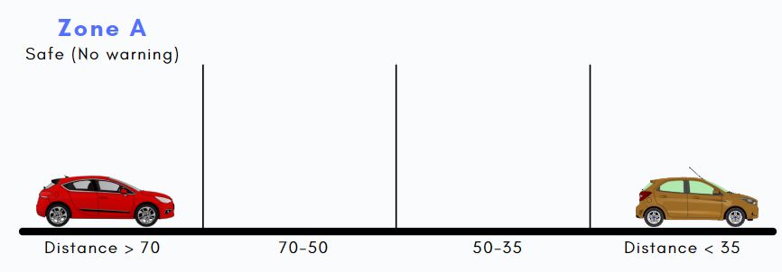
Problem Solution
Distance between vehicles and Speed of car segmented into four different zones:
Zone A
Zone B
Zone C
Zone D
if distance is greater than 70 units and speed confined between 80-110 units the No warning.

Slide 7
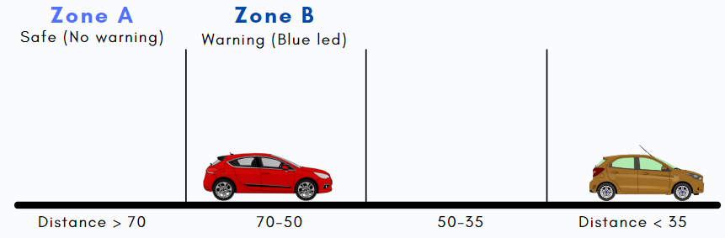
Problem Solution
Distance between vehicles and Speed of car segmented into four different zones:
Zone A
Zone B
Zone C
Zone D
if distance confined between 50-70units and speed confined between 80-110 units then Only visual warning blue LED will glow to alert
(In this zone driver has to pay attention).

Slide 8
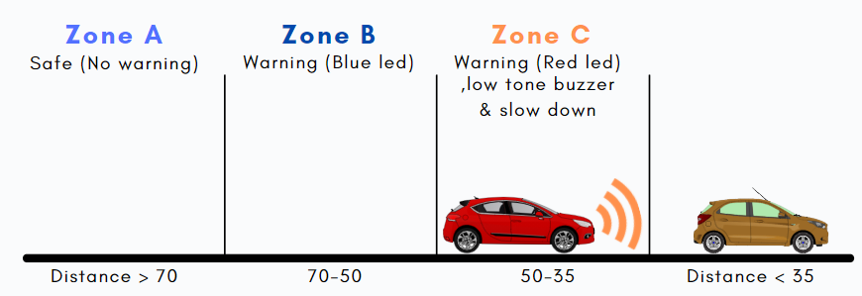
Problem Solution
Distance between vehicles and Speed of car segmented into four different zones:
Zone A
Zone B
Zone C
Zone D
if distance confined between 35-50 units and
speed confined between 40-80 units then
visual warning red LED will glow to alert and Buzzer will start at low frequency and slow
down (In this zone driver has to pay attention).

Slide 9
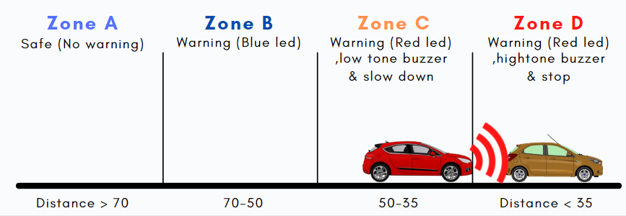
Problem Solution
Distance between vehicles and Speed of car segmented into four different zones:
Zone A
Zone B
Zone C
Zone D
if distance is less than 35 units and speed less than 40 units then Both visual and audio warning red LED glow to alert and Buzzer will start at high frequency and break ( Driver has to take necessary action to avoid collision).

Slide 10
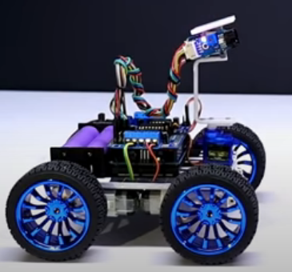
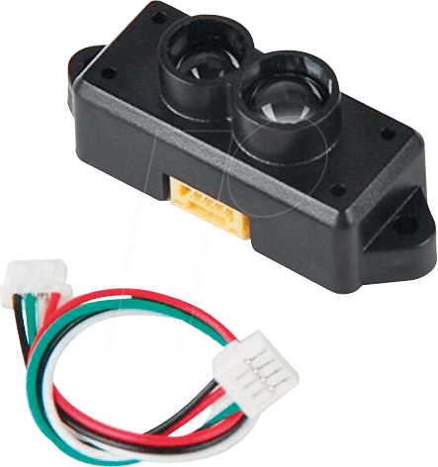
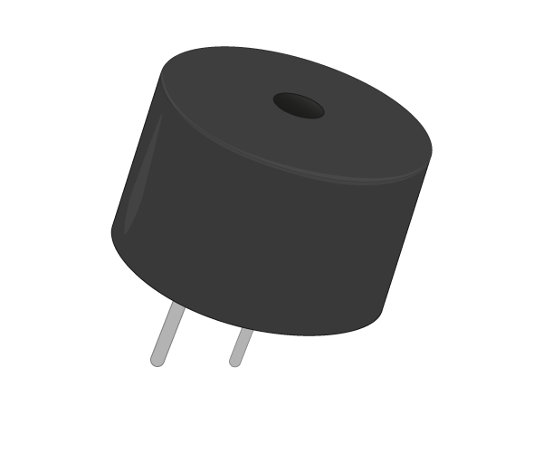
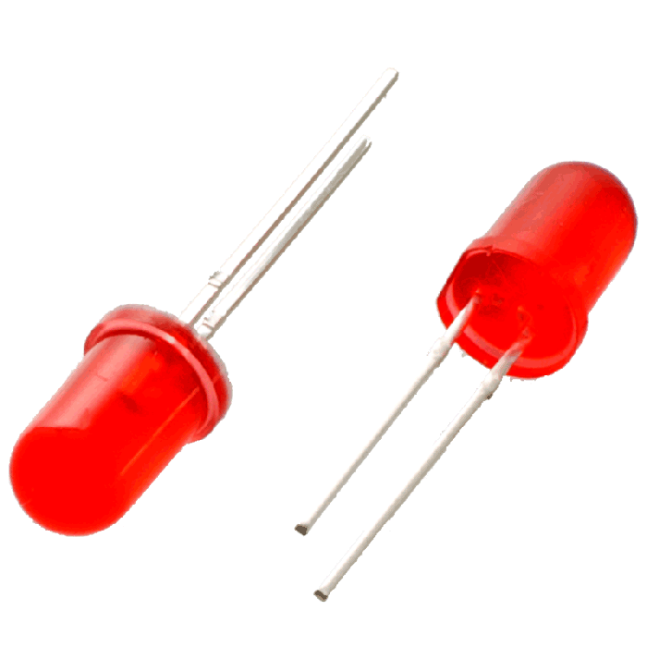
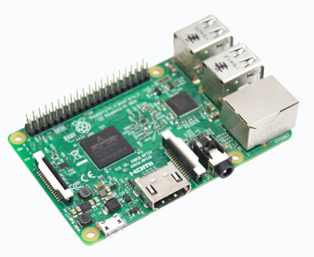
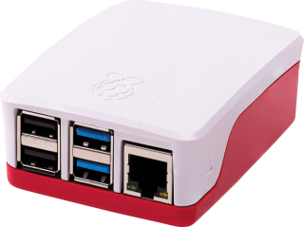
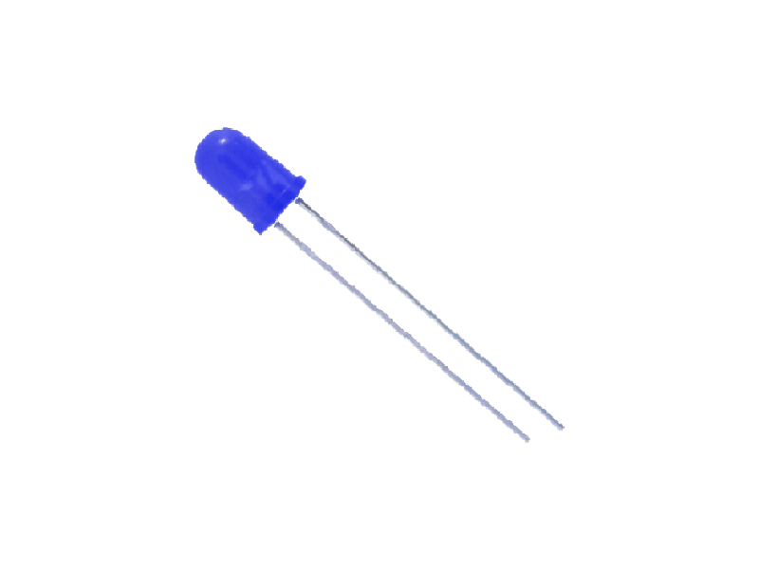
Components and Material Required
Arduino Car
TF Mini LiDAR
Raspberry pi
Piezo Buzzer
LED

Slide 11
Implementation
First phase
Is the Arduino code for your information method of transferring result is used trough Bi directional serial communication between Arduino and raspberry pi using the UART protocol. Moreover, the Arduino take the proper action by initiate an alarm (Visual and auditory). Next part will explain two phases in details.
Software implementation consist of two
phases
Second phase
Is machine learning model that are loaded in Raspberry pi that can predict and classify danger based in inputs that is given to inputs are(speed , average speed ,distance and moved).After model classify level of danger which can be level A or B or C or D it transfers result to the Arduino.

Slide 12
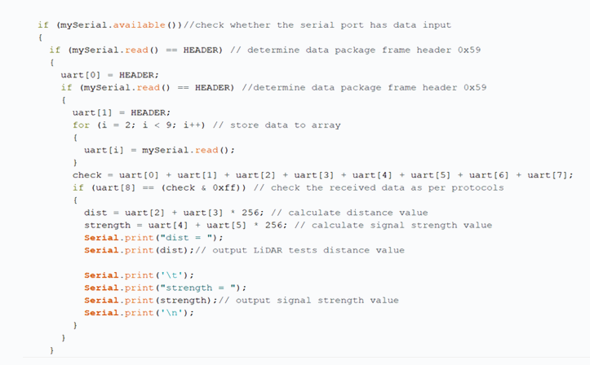
Implementation
Following steps demonstrate previous phases:
Step 1
This code is implemented on Arduino IDE which measure distance by TF-mini.

Slide 13
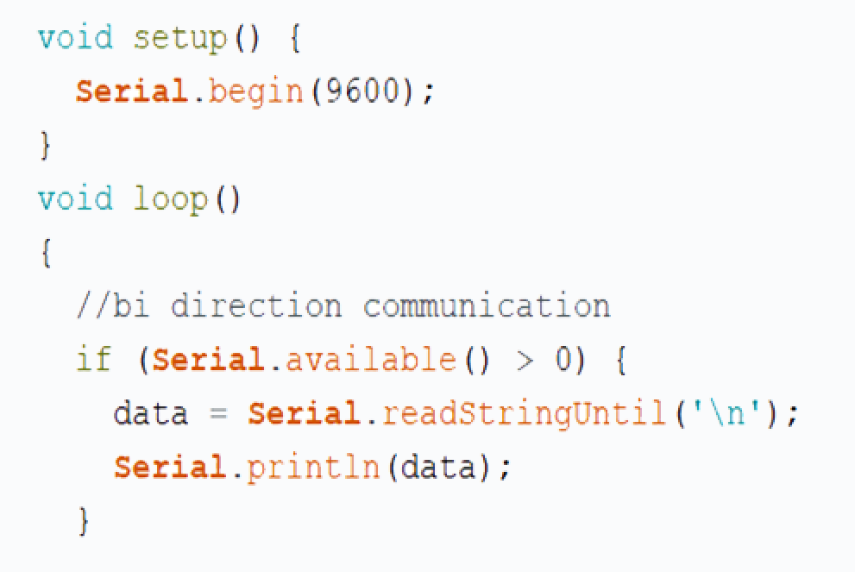
Implementation
Step 2
Check Bi directional serial communication between Arduino and Raspberry pi using the UART protocol
Arduino communication code:

Slide 14
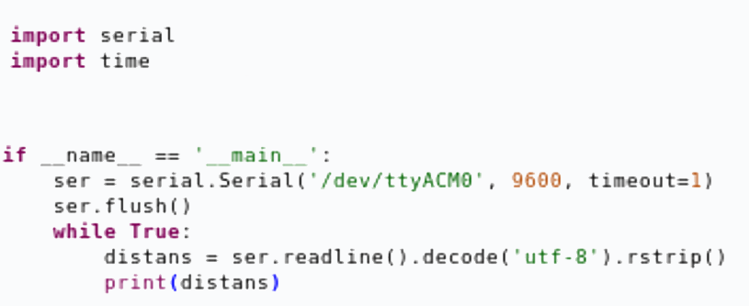

Implementation
Raspberry pi communication code:

Slide 15
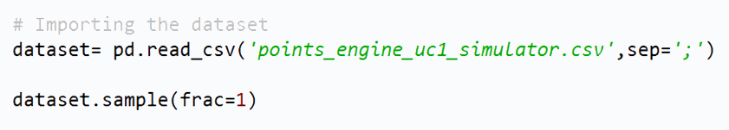
Implementation
Step 3
Machine learning model that are loaded in Raspberry pi that can predict and classify danger based in inputs that is given
Before we build our model we search for Appropriate dataset which help us to build good Model.
Then we used dataset that were provided by (Zenodo) and contain variables and records of data.
After this Step we have determined the number of classes ( Zone ) to implement it by our model.

Slide 16
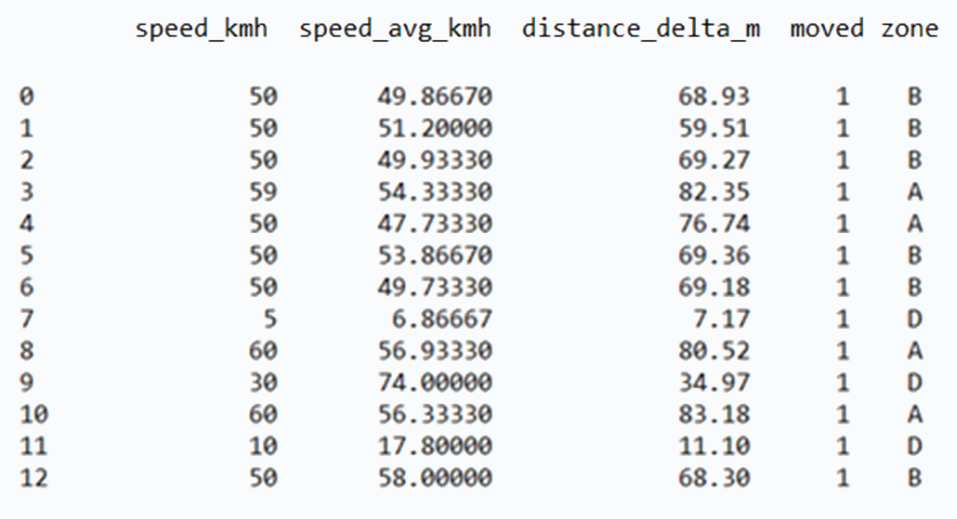
Implementation
Samples of dataset

Slide 17
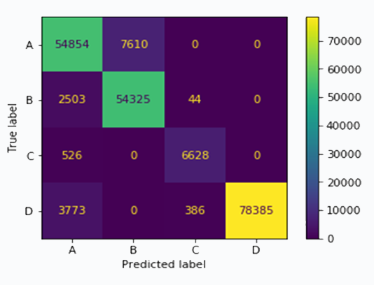
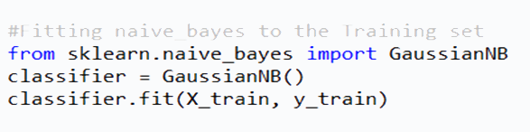
Implementation
Next part choosing the most suitable algorithm that achieve high efficiency so we select many algorithms and test them to select the accurate one, the selected as follows:
Naive Bayes With accuracy = 92%

Slide 18
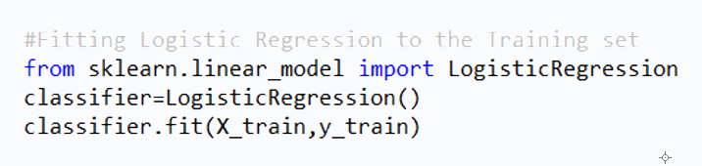
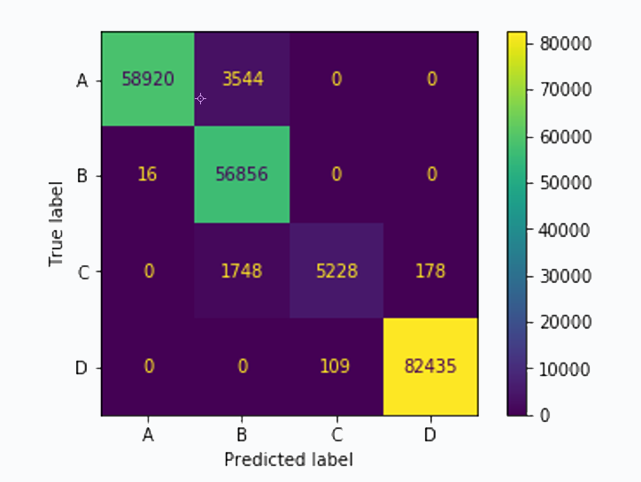
Implementation
Logistic Regression With accuracy = 97%

Slide 19
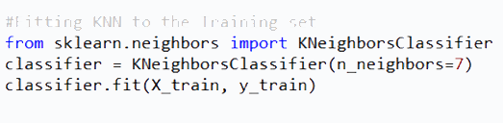
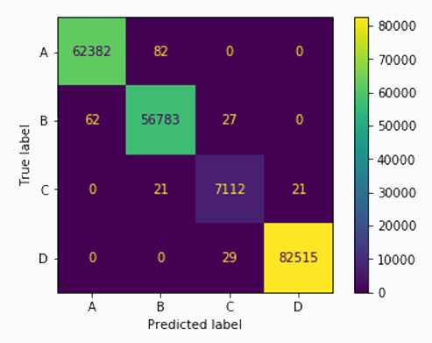
Implementation
K-Nearest Neighbors With accuracy = 99%
Therefore, according to the previous KNN achieved the highest accuracy we use it in implementation.

Slide 20
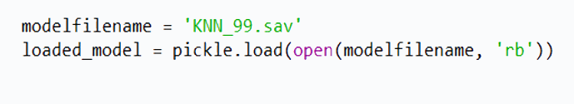
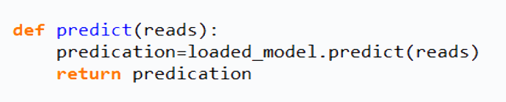
Implementation
Next part based on accuracy of KNN, we try to test model
load KNN model from disk
predict function to return the right zone

Slide 21
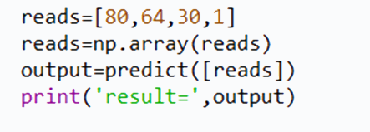
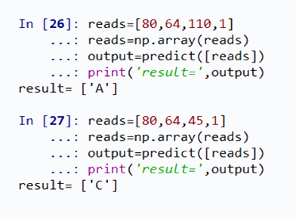
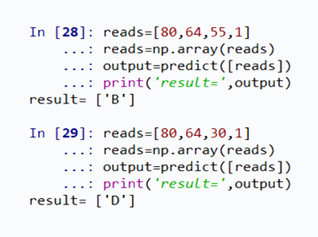
Implementation
call function to test the model and print the result
samples of testing output

Slide 22
Architecture flowchart
Start
TF measure
No Alarm
(Zone A)
Model classify
Class A
yes
Blue LED Alarm
(Zone B)
No
Class B
yes
Slow Down,
Red LED Alarm, low Buzzer
(Zone C)
No
Class C
yes
Red LED
Alarm, High
Buzzer , Break
(Zone D)
No
Class D
yes
No

Slide 23
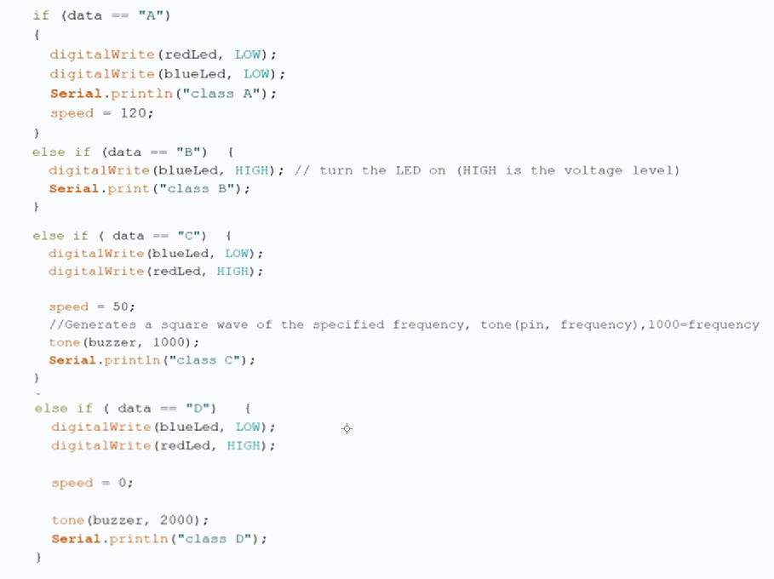
Implementation
Distance between vehicles and Speed of car segmented into four different zones:

Slide 24
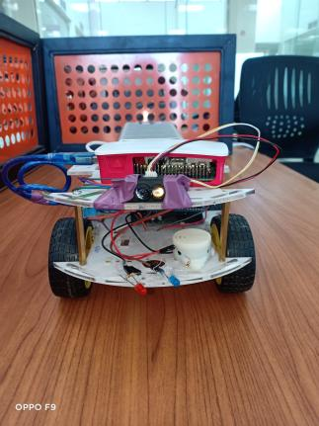
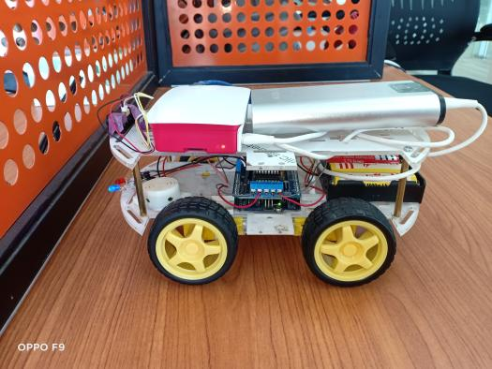
Prototype

Slide 25
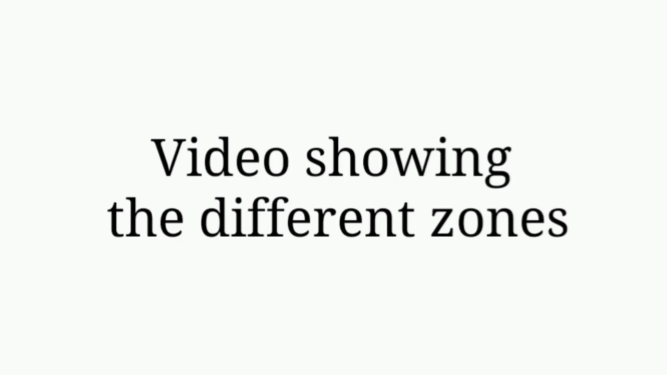
Prototype

Slide 26
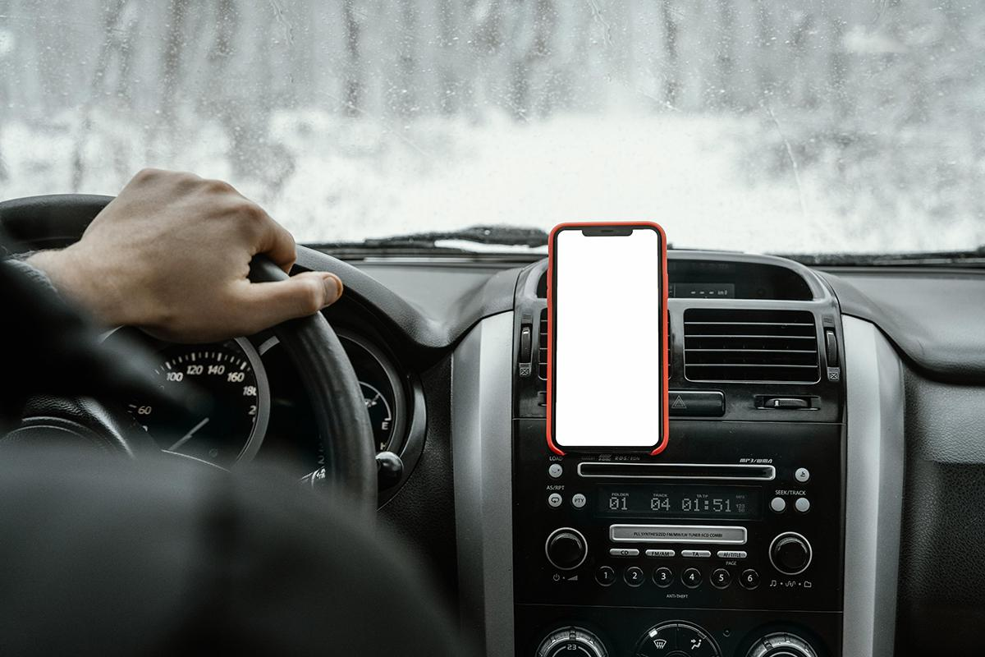
Thanks

